Slide 1
ELITE POLYTECHNIC INSTITUTE MOGRA,HOOGHLY MECHANICAL ENG.DPT.GRP-E
SCISSOR LIFTING MACHINE
BY USING SCREW JACK MECHANISM

Slide 2
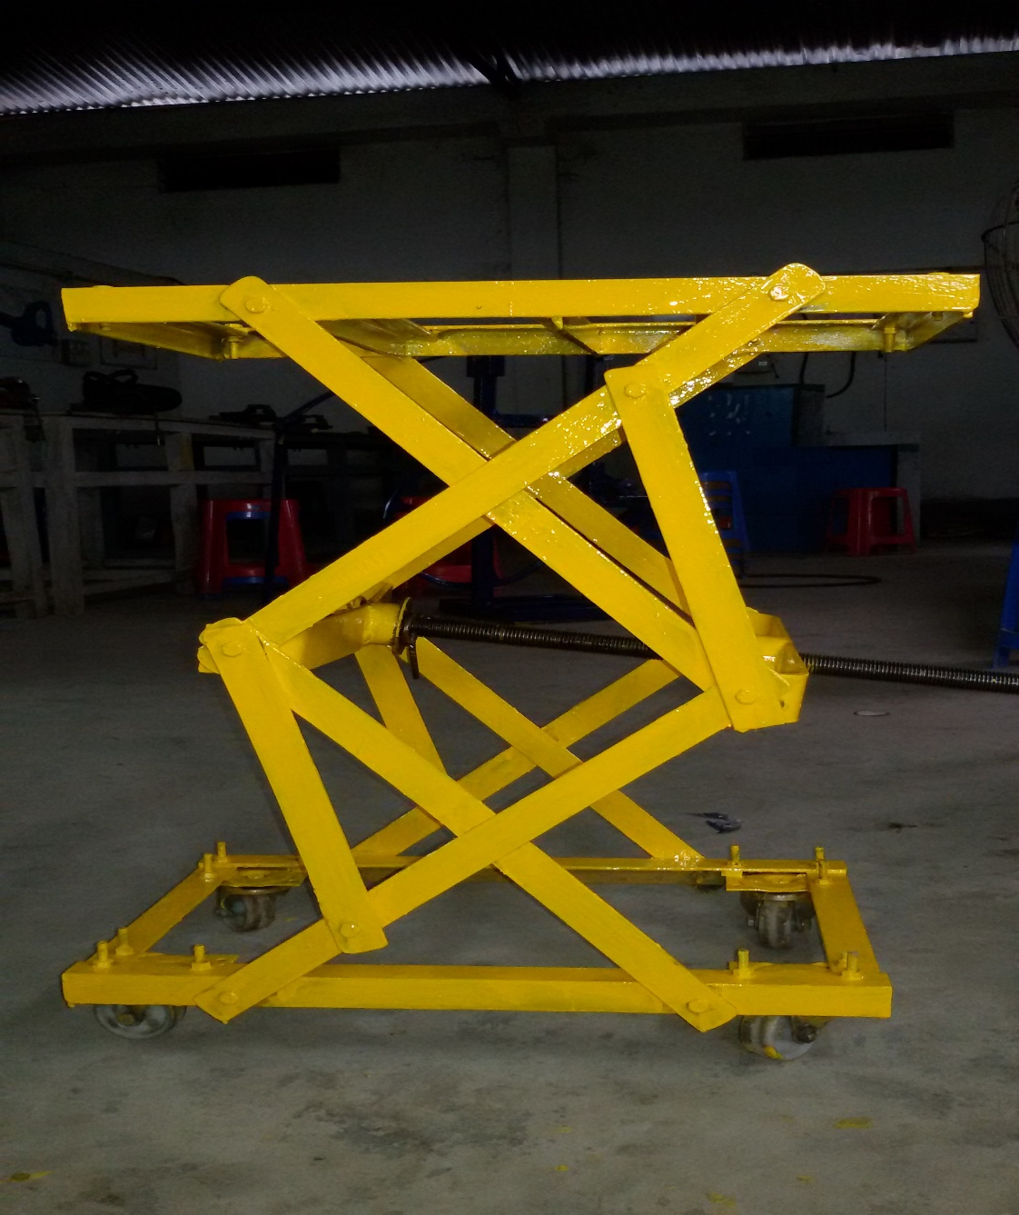
OUR PROJECT

Slide 3
CONTENTS
INTRODUCTION
OBJECTIVE
WORKING PRINCIPLE
DESING
MATERIAL USED
EQUIPEMENT USED
TOOL USED
ESTIMATION
COSTING
10 .ADVANTAGES
11 .DISADVANTADES
12 .PROBLEM FACED
13 .SOLUTION
14 .SCOPE
15 .REFERENCE
16 .CONCLUSION

Slide 4
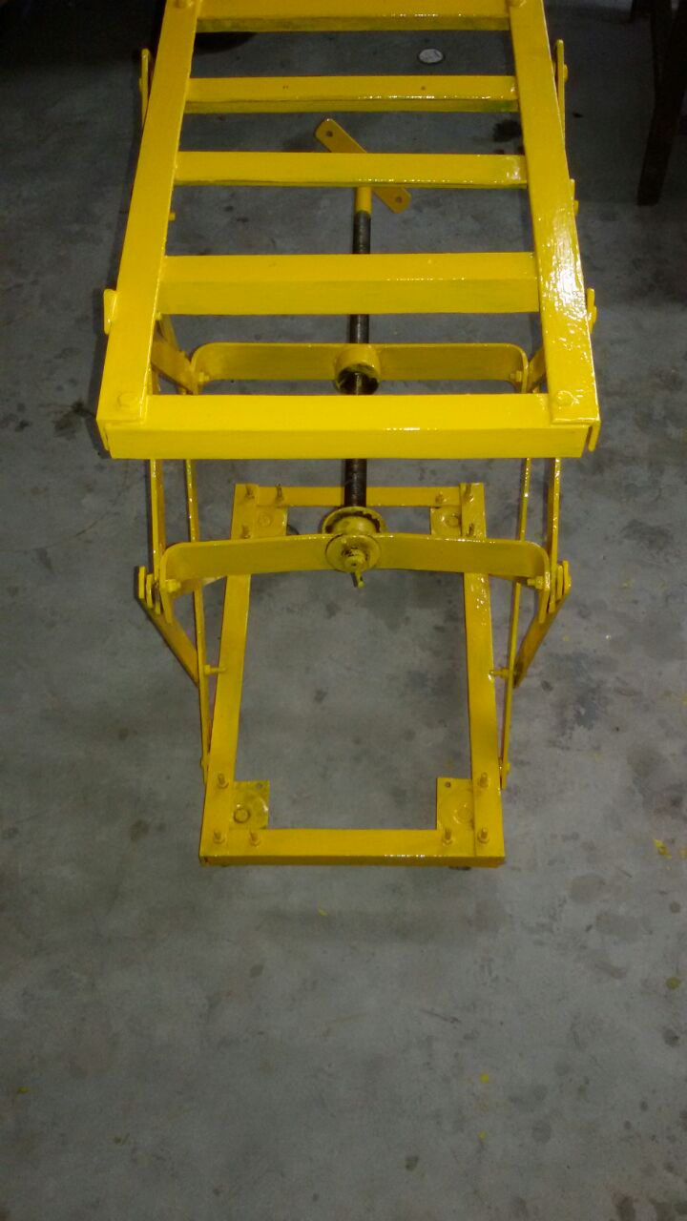
INTRODUCTION:
The most basic scissor jack design is truly engineering at its finest. with the power to magnify input forces.
Scissor jacks allow us to raise vast loads using only a fraction of the force ordinarily needed.
The main and most important item is use for project is a power screw.

Slide 5
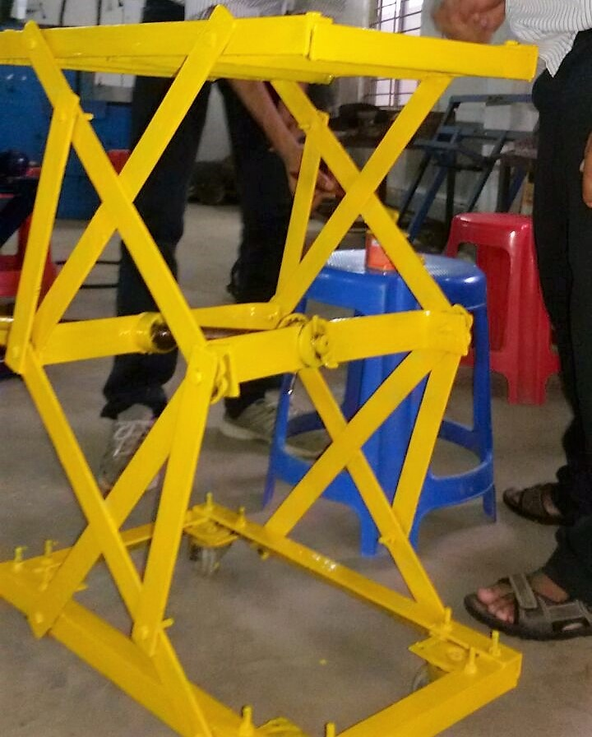
OBJECTIVES:
To know the working principle of screw jack.
It can be used for lifting heavy load.
We don’t have enough knowledge about programming, electronics etc, so we try to use only our mechanical knowledge, and our experience through this project work which we have learned in 3 years.

Slide 6
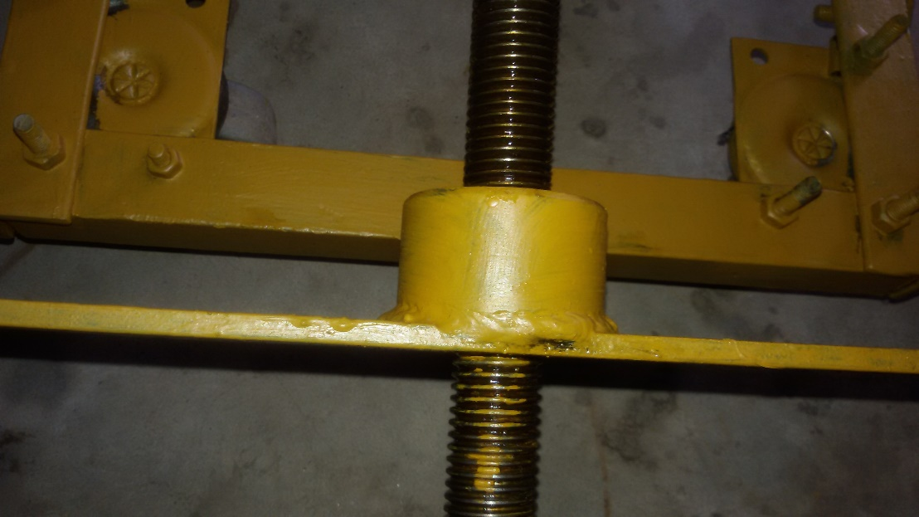
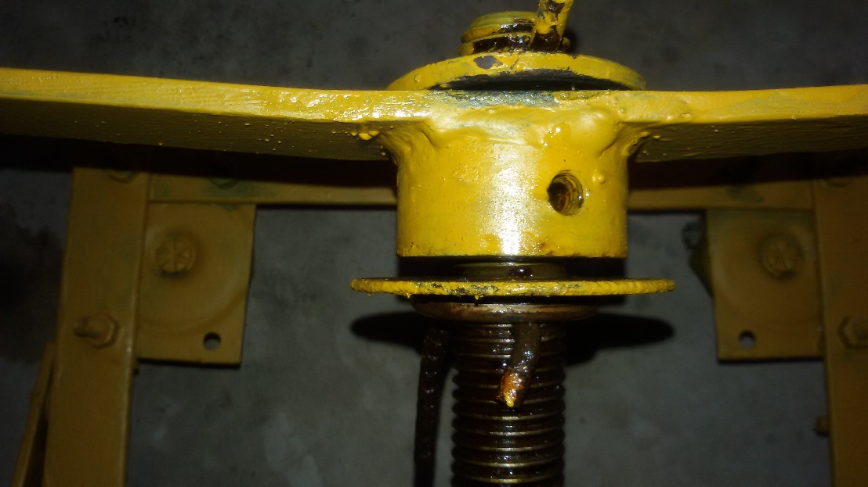
WORKING PRINCIPLE
A screw is a mechanism that converts rotational motion to liner motion, and a torque (rotational force) to a linear force. It is one of the six classical simple machines. The most common form consists of a cylindrical shaft with helical grooves or ridges called threads around the outside. The screw passes through a hole in another object or medium, with threads on the inside of the hole that mesh with the screw’s threads . When the shaft of the screw is rotated relative to the stationary threads, the screw moves along it axis relative to the medium surrounding it.
In screw mechanisms either the screw shaft can rotate through a threaded hole in a stationary object, or a threaded collar such as nut can rotate around a stationary screw shaft .
Geometrically, a screw can be viewed as a narrow inclined plane wrapped around a cylinder.
THREAD
Bush

Slide 7
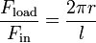
MECHANICAL ADVANTAGES:
The mechanical advantage of a screw jack, the ratio of the force the jack exerts on the load to the input force on the lever, ignoring friction is
Where
is the force the jack exerts on the load
is the rotational force exerted on the handle of the jack
is the length of the jack handle, from the screw axis to where the force is applied.
is the load of the screw.
This derives from two factors, the simple lever advantage of a long operating handle and also the advantage of the inclined plain of the lead screw. However, most screw jacks have large amounts of friction which increase the input force necessary, so the actual mechanical advantage is often only 30% to 50% of this figure.

Slide 8
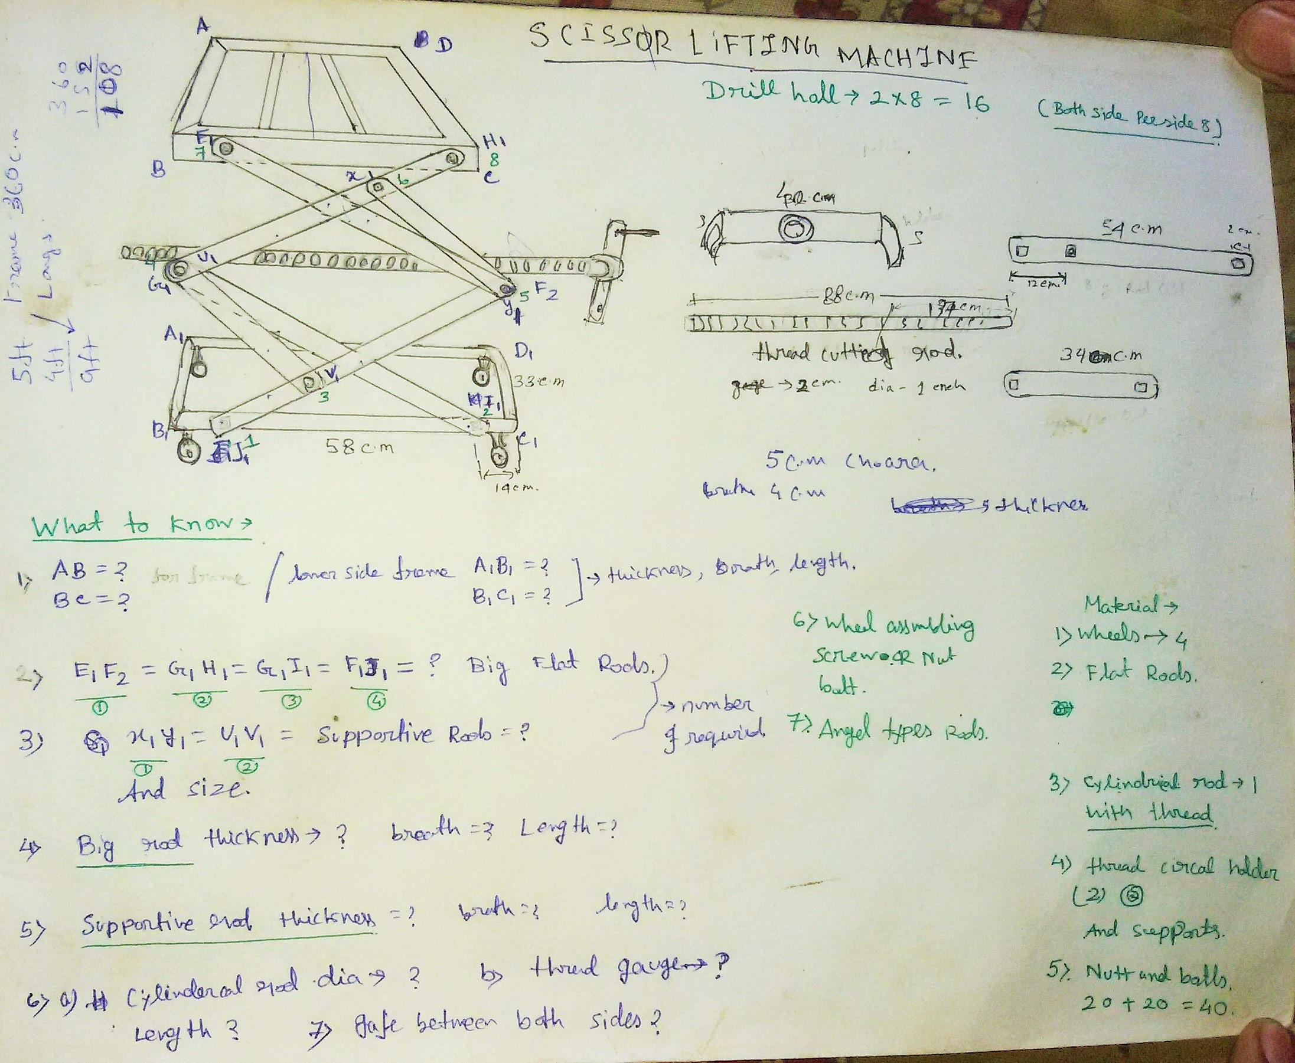
LAY OUT:
Free hand sketch

Slide 9
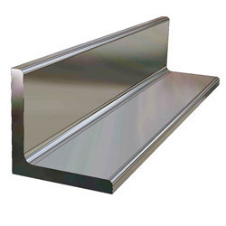
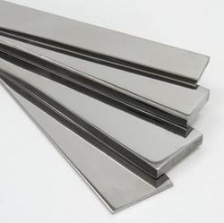
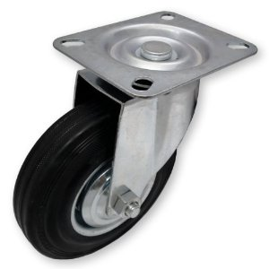
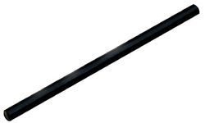
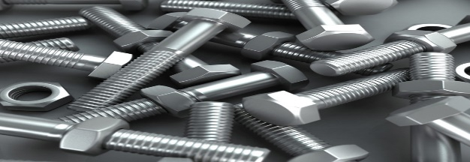
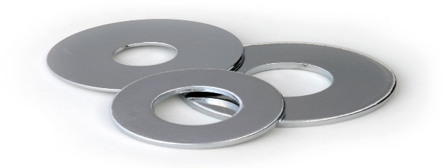
MATERIAL USED
Angle (4x4 cm) : It’s used for making the upper & lower frame.
Plates (0.5x4 cm) : It’s used for making the main structure , which actually hold the weight.
Trolley Wheels: It’s used for transport the machine one place to another.
Rod (1”dia ) : It’s used for making the screw jack ,( basically the heart of this machine)
Nuts and Bolts (1.5”) : It’s used for assemble the whole frames and structure
Washers: It’s used to make the distance between each plates for reducing the friction.

Slide 10
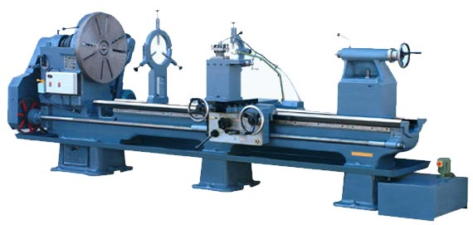
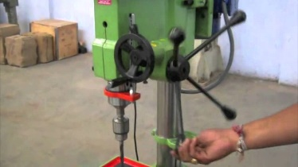
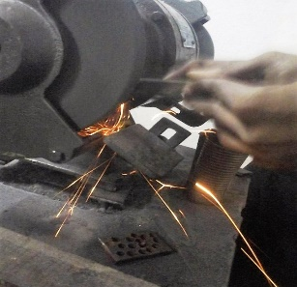
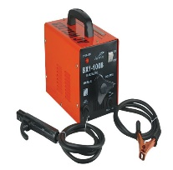
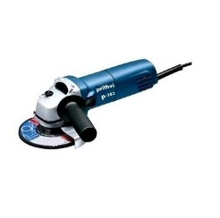
EQUIPMENT USED
Lathe : It’s used for cutting the (1.5mm pitch) V-thread.
Drilling Machine : It’s used for drilling the plates.
Grinding Machine : Grinding is used to finishing the metal.
Welding machine (Arc) : It’s used for welding the metal
plates.
Metal cutting Machine : It’s used for cutting the metal
plates .

Slide 11
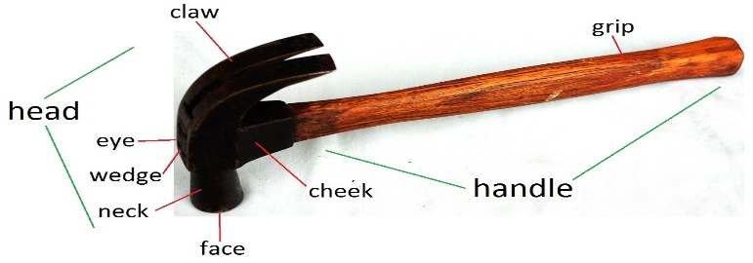
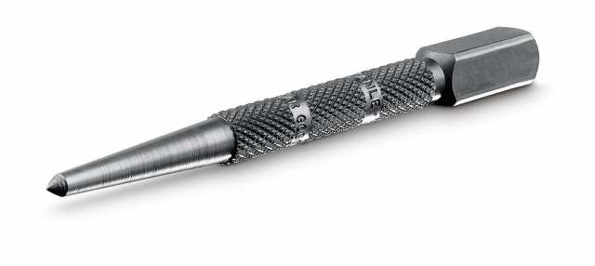
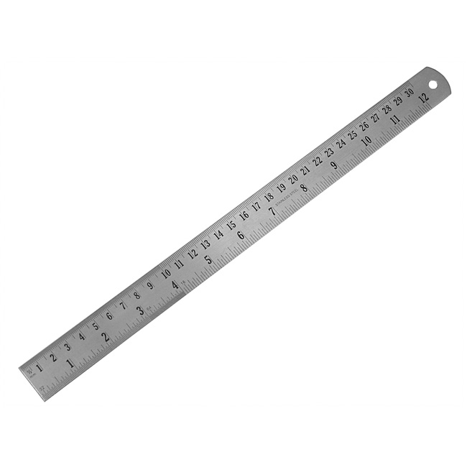
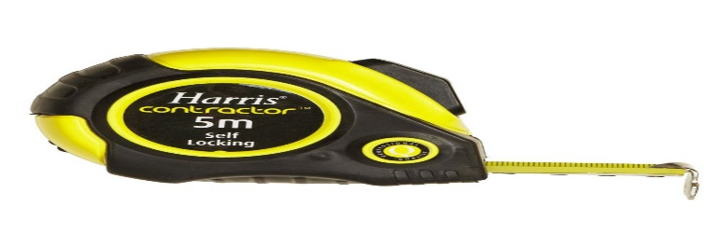
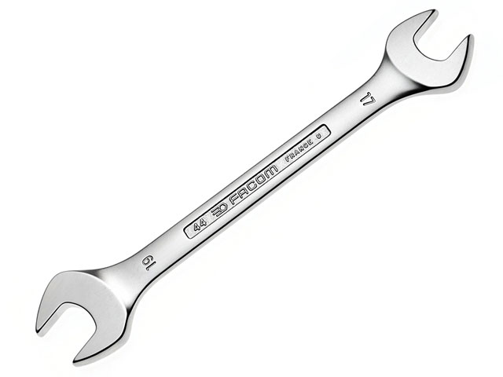
TOOL USED:
HAMMER : It is used for hammering the metal .
PUNCH : It is Used to marking the center point.
STEEL RULE : It is used for measuring and marking.
MEASURING TAPE : Basically it’s used for measuring circular dimensions.
SPANNERS : It’s used to provide grip and mechanical advantage in applying torque to turn object- such as nuts & bolts.

Slide 12
PROCUDER
First we estimate the project.
Then we purches all the necessary material like metal, nut bolt etc. form the market.
Take the measurement and cut the metal in size according to our need.
We drill the all the plate as required.
We grinding the plate end roundly.
We made the v-thread cutting from the outside.

Slide 13
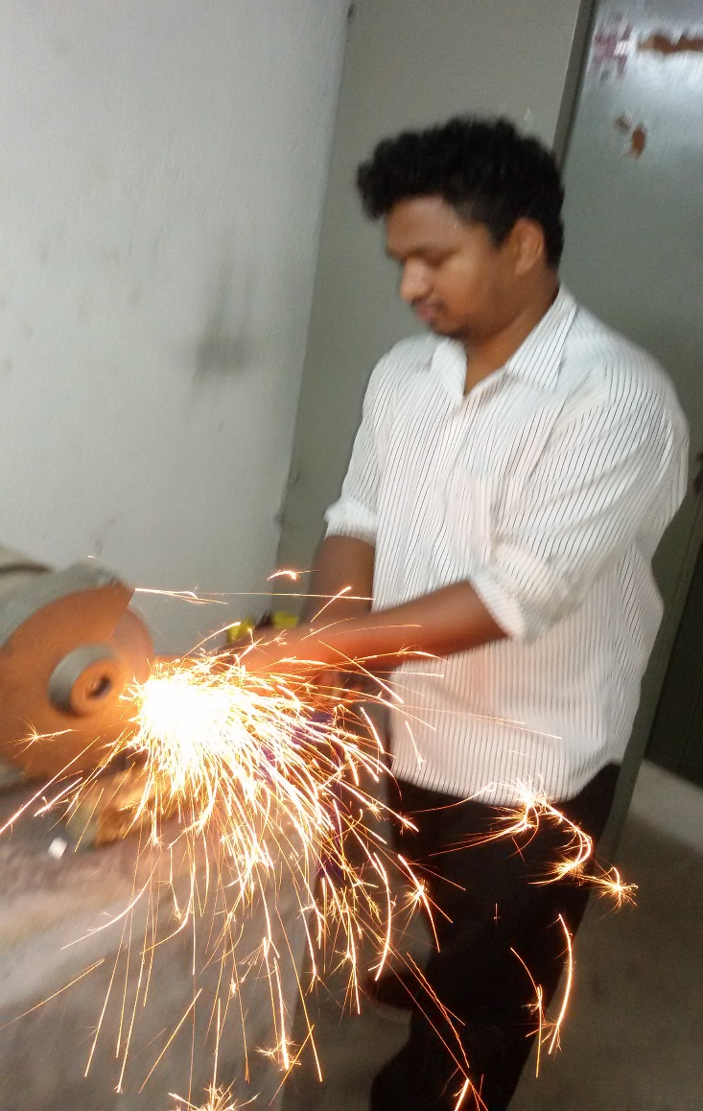
We weld the female part and bush with the banded plate.
Then we assemble all the part together.
We have faced many problem in assembling but any how we have solve the problem with the help our Department teachers
After completely assembling of our project we have test our machine the how much it can lift the load and height and working properly or not.
After successfully test we have seen that it can lift the load up to 100kg.
Then we tight all the nut and bolt properly and then we color it.

Slide 14
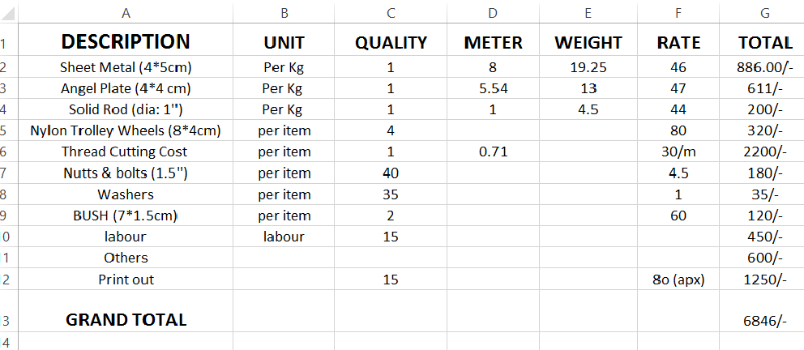
ESTIMATION

Slide 15
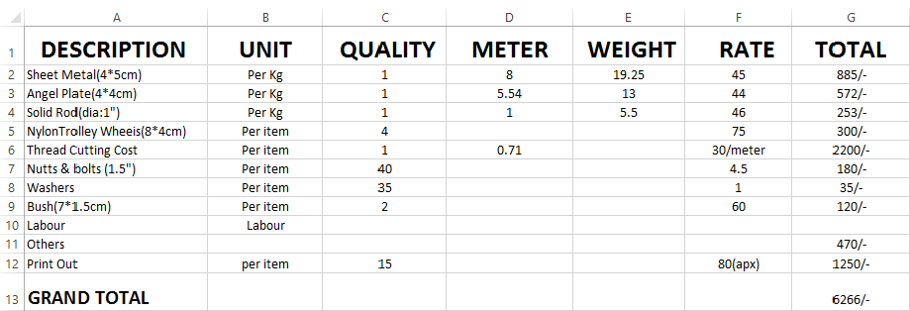
COSTING:

Slide 16
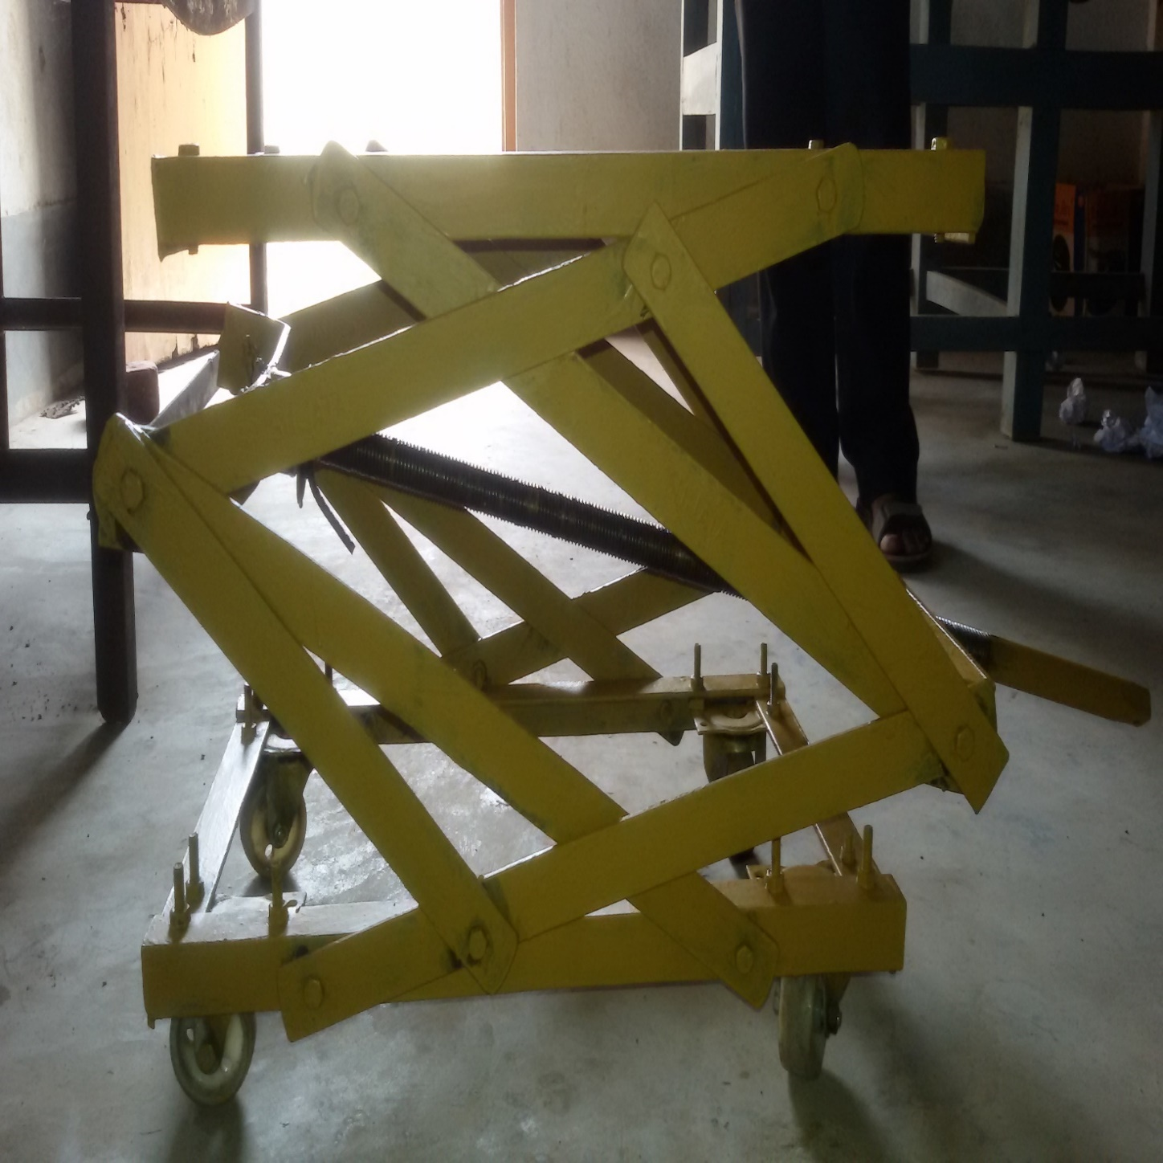
ADVANTAGES:
Easy to operate.
It’s not require large place for use.
It’s accessible & can be customized easily.
With a versatile nature , they are easily adaptable with different terrains and climates.

Slide 17
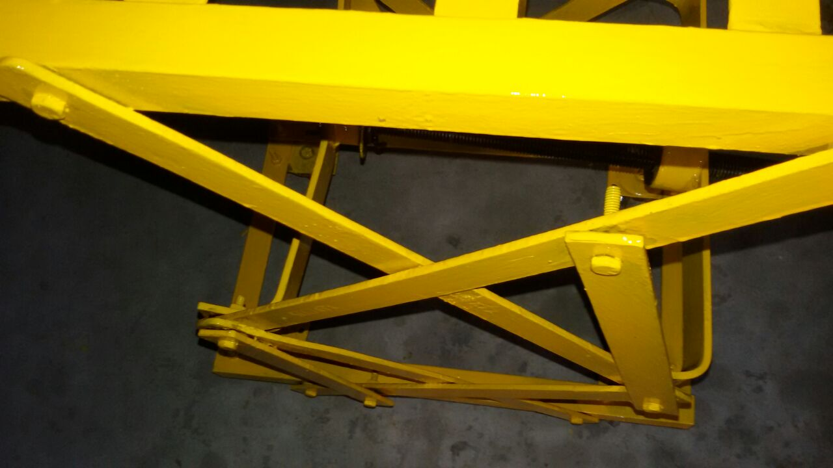
DISADVANTAGES:
It’s also have some limitation (M.A and V.R)
In this machinery if any parts damaged Then it’s can’t work properly.
It’s always needed Lubrication for smooth function.

Slide 18
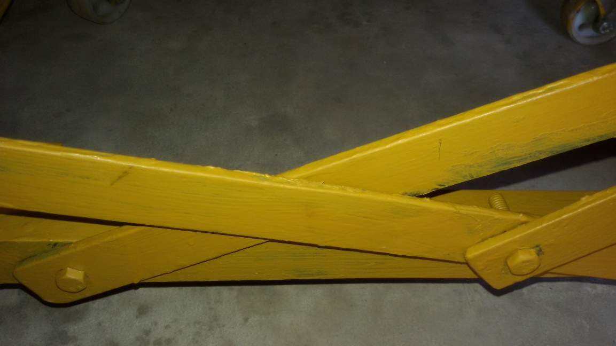
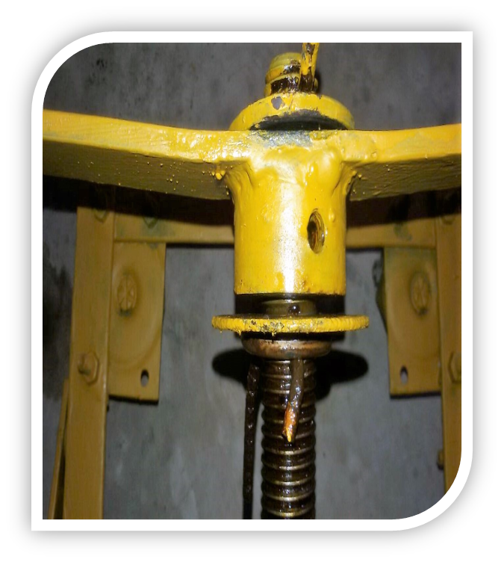
PROBLEM FACED :
Raising of the top plate not parallel.
Alignment of the screw with nut.
High fraction between the sliding plate.
We have made V-thread screw . It would have been better if we have made square thread for smooth operation.

Slide 19
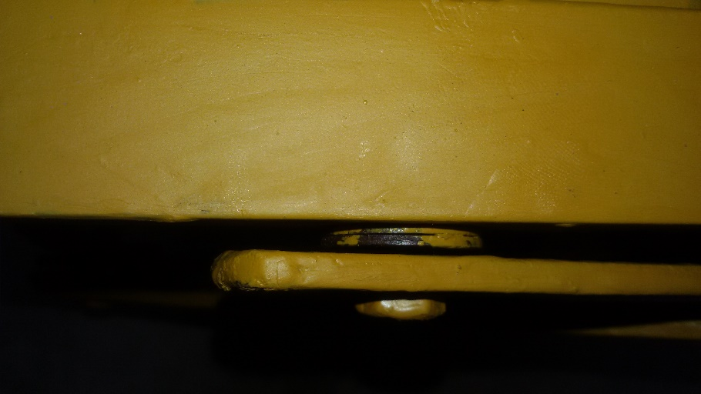
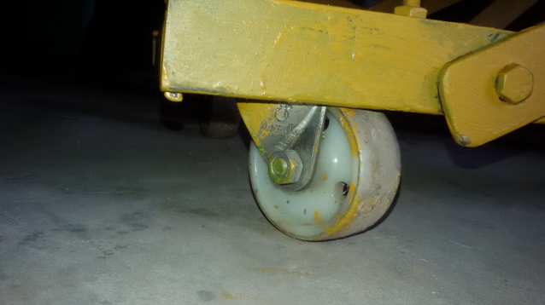
S0LUTIONS:
We change the direction of Nut and Bush.
We bend the plate properly which is attach with nut and bush.
We used washers to reduce the friction in between to plate.
We have used more lubrication for smooth rotation of V-thread.
washers
wheels

Slide 20
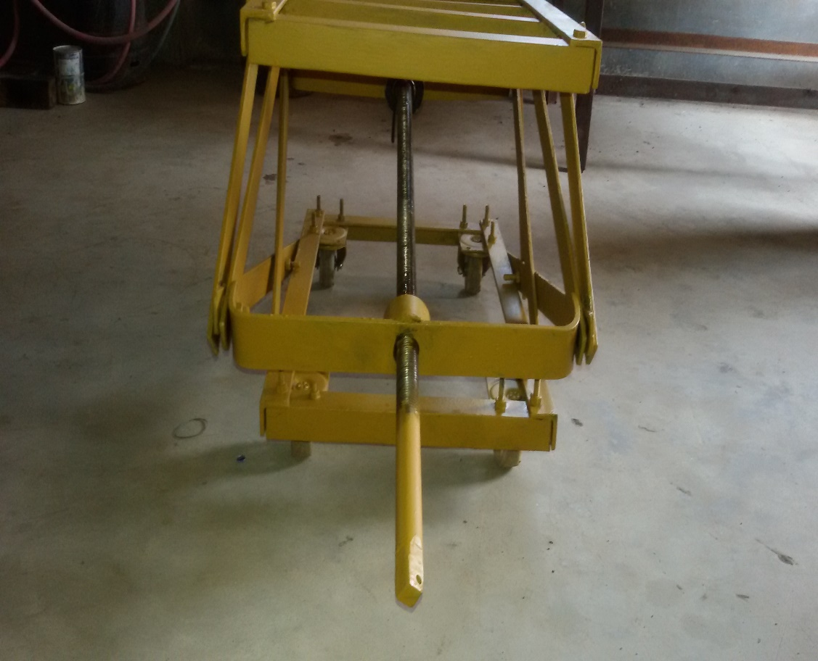
FUTURE SCOPE:
It can be upgraded with hydro pneumatic system or hydraulics mechanisms.
It is most comfortable transportations system for goods carrying in industry use.

Slide 21
CONCLUSION:
It was a great opportunity for us to learn how to work in a team, face problem, find solution , and implement a project . Above all we got the spirit of team work.
We Learn
How to design a project from Preliminary stage.
How to select different material.
Use of different machine, tools, operation etc.
Method of estimation and costing.

Slide 22
REFERENCES:
A text book of Machine Design by R.S.Khurmi,J.K.Gupta.
Design of machine elements by V.B.Bhandari.
Design of machine elements by K.Rao.
Design of Machine Elements by Farazdak Haideri.
Machine Design by S.G.Kulkarni.
http://en.wikipedia.org/wiki/Jack_(device).
http://hubpages.com/hub/Automobile-Jacks.
http://www.powerjacks-de.com/Screw-Jacks-FAQ.html.
http://www.radicon.com/screw-jacks.php.
http://www.powerjacks.com/PowerJacks-History-The-Screw-Jack-Story.php.

Slide 23
THANK YOU

